Slide 1
SOFT130015 Database Design
Course Information

Slide 2
About TA
王颖
邢晓渝

Slide 3


About Instructor
吴毅坚
软件工程实验室，软件楼403
Email:
wuyijian@fudan.edu.cn
电话：
13817374753
QQ:
2745859 ←
微信 →
欢迎联系

Slide 4
About the course
Textbook
Database System Concept (6th ed.)
English version
References（具体的数据库的使用）
Database System Concept (5th ed.)
Practice-based (Oracle, SqlServer, MySql…)
Theory-based (to be introduced during the course)
Focuses
Basic concepts of relational database
Application related issues & practical skills（理论与实践的不同，两者如何平衡。在实践中要将原则与实际决策结合起来）
Assessment
1 Project and 2~3 Labs
After-class assignments and in-class quizzes
Final examination (open book, open notes)

Slide 5
About the course (cont.)
Final score is given according to your overall performance.
Project: 25~35%
Labs: 10~15%
Homework, Quizzes: 10~15%
Final: 45~55%
Actual percentage may vary.

Slide 6
Lecture 1 Introduction

Slide 7
Contents
Concepts based on the textbook
Why database ? An Introduction CH1
Relational Model and SQL
Relational Model CH2
SQL CH3-5
Other query languages CH6
Database Design
Entity-Relationship Model CH7
Relational Database Design CH8
Application Design and Development CH9（自己过）
Database System Issues（数据库系统底层的设计相关，可以帮助我们理解一些查询和选择等的实现机制）
Storage CH11
Indexing CH12
Transaction CH15

Slide 8
WHY Database?
Database Everywhere
Banking: transactions
Airlines: reservations, schedules
Universities: registration, grades
Sales: customers, products, purchases
Online retailers: order tracking, customized recommendations
Manufacturing: production, inventory, orders, supply chain
Human resources: employee records, salaries, tax deductions

Slide 9
WHY Database?
DBMS contains information about a particular enterprise
Collection of interrelated data
Set of programs to access the data
An environment that is both convenient and efficient to use

Slide 10
Why Database?
Managing Data?
File System
In the early days, database applications were built directly on top of file systems
Drawbacks of using file system to store data
See next page

Slide 11
Why Database?
Drawbacks of using file systems to store data
Data redundancy and inconsistency
Multiple file formats, duplication of information in different files
Difficulty in accessing data
Need to write a new program to carry out each new task
Data isolation — multiple files and formats
Integrity problems
Integrity constraints (e.g., account balance > 0) become “buried” in program code rather than being stated explicitly
Hard to add new constraints or change existing ones

Slide 12
Why Database?
Drawbacks of using file systems to store data (cont.)
Atomicity problems of updates
Failures may leave data in an inconsistent state with partial updates carried out
Example: Transfer of funds from one account to another should either complete or not happen at all; otherwise inconsistency occurs
Concurrent access anomalies
Concurrent access by multiple users needed for performance
Uncontrolled concurrent accesses can lead to inconsistencies
Security problems
Hard to provide user access to some, but not all, data
Database systems offer solutions to all the above problems!

Slide 13
Database Design
The process of designing the general structure of the database
(actually, database for applications)
Logical Design – Deciding on the database schema. Database design requires that we find a “good” collection of relation schemas.
Business decision – What attributes should we record in the database?
Computer Science decision – What relation schemas should we have and how should the attributes be distributed among the various relation schemas?
Physical Design – Deciding on the physical layout of the database

Slide 14
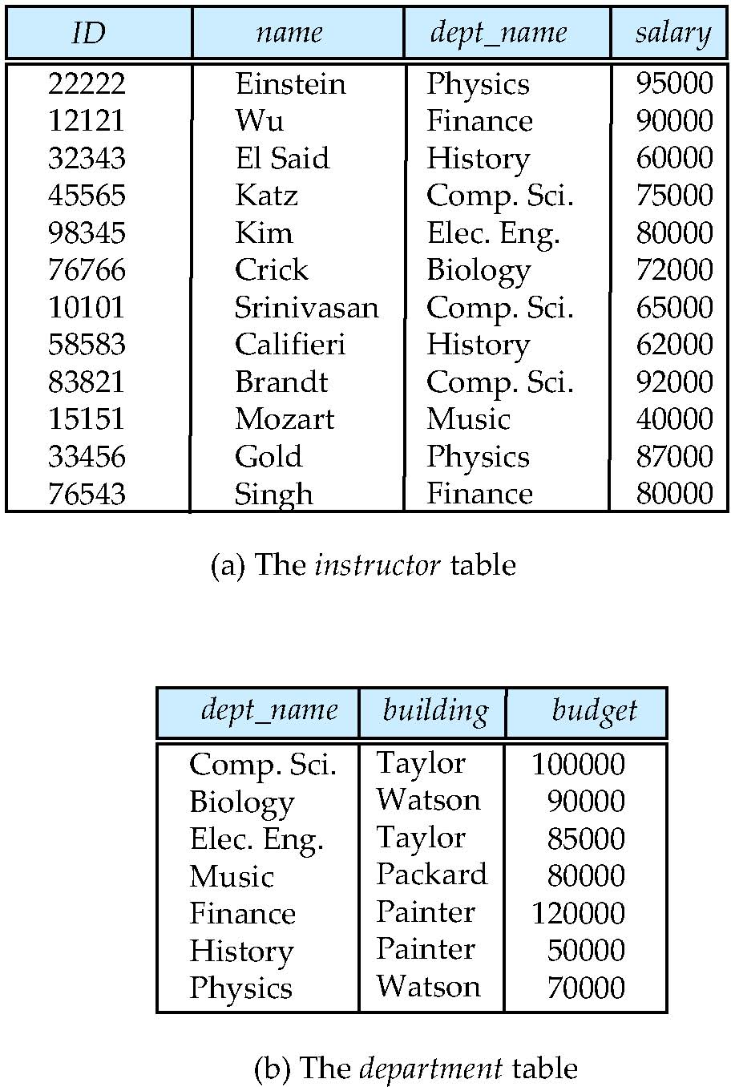
WHAT is a Database?
It may look like …
It consists of: （以关系型数据库为例）
- Tables表
- Attributes属性 (Fields字段)
- Tuples 元组(Records)
- Constraints 约束(Logical relationship among data数据间的逻辑关系。例如：不同的表格之间存在的信息存在从属关系。例如一张表中老师所在院系对应院系表中对应院系的信息。如果一个表中老师对应的院系在下面院系表中找不到，则不一致，数据库则要保护一致性。)
数据库中有两个关键词-关系relation和约束Constraints。

Slide 15
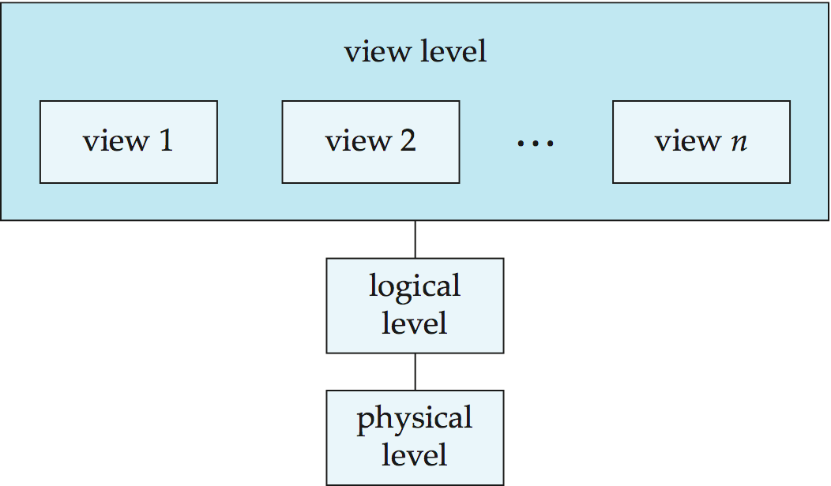
WHAT is a Database?
View of Data
Physical level: how a record is stored
Logical level: relationships among data, incl. data structure, data type
View level: data visited by application programs; hide data for security purposes

Slide 16
WHAT is a Database?
Data Abstraction
Physical: How a record is stored
Logical: data, and the relationships among data
type instructor = record
ID : string; name : string; dept_name : string; salary : integer;
end;
Similar to data structure and types
View: Provide application access; Information hiding
Database designers
Application developers

Slide 17
WHAT is a Database?
Schema (模式) - the logical structure of the database 数据结构
Analogous to type information of a variable in a program (data structure)
Physical schema: database design at the physical level
Logical schema: database design at the logical level
Instance (实例) - the actual content of the database at a particular point in time。（例如：某时刻有一张表有10个记录，那么这个表是个实例。之后加了一条，这个表还是一个实例。）
Analogous to the value of a variable

Slide 18
WHAT is a Database?
Physical Data Independence物理数据独立性
The ability to modify the physical schema without changing the logical schema
Applications depend on the logical schema应用是依赖于逻辑层的，所以物理层的变化不影响逻辑层，对于应用来说物理层变化也不影响它。
Interfaces between levels
In general, the interfaces between the various levels and components should be well defined so that changes in some parts do not seriously influence others.

Slide 19
WHAT is a Database?
Storage Manager
Provides the interface between the low-level data stored in the database and the application programs and queries查询 submitted to the system
Interaction with the file manager
Efficient storing, retrieving and updating of data
Design Issues of Storage Manager
Storage access
File organization
Indexing and hashing

Slide 20
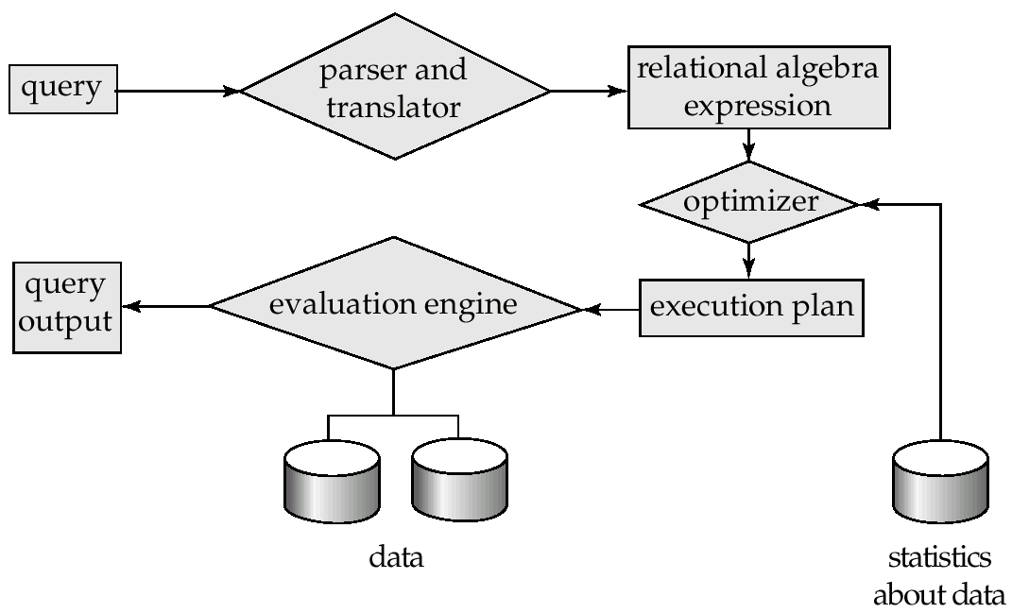
WHAT is a Database? -使用数据库
Query Processing查询机制
1. Parsing and translation
2. Optimization
3. Evaluation

Slide 21
WHAT is a Database?
Transaction Management事务管理
Transaction-management component
Database survives system failure and transaction failure
Database remains in a consistent (correct) state despite of failures确保完整一致。例如：确保不出现转账一边转出去一边没收到
Concurrency-control management并发控制
Controls the interaction among the concurrent transactions例如多人同时选课而限制人数
Ensure the consistency of the database

Slide 22
WHO use a Database?
Database administrator's duties include:
Schema definition表结构定义或者模式定义
Storage structure and access method definition例如：哈希结构。
Schema and physical organization modification
Granting user authority to access the database这里的user指数据库面对的用户。
Specifying integrity constraints
Acting as liaison with users
Monitoring performance and responding to changes in requirements性能
Database users
Application programmers通过应用开发接口使用数据库
Sophisticated users直接通过数据库的访问终端
Specialized users特定用户
Naïve users直接通过应用系统使用数据库的人，通常运用界面使用

Slide 23
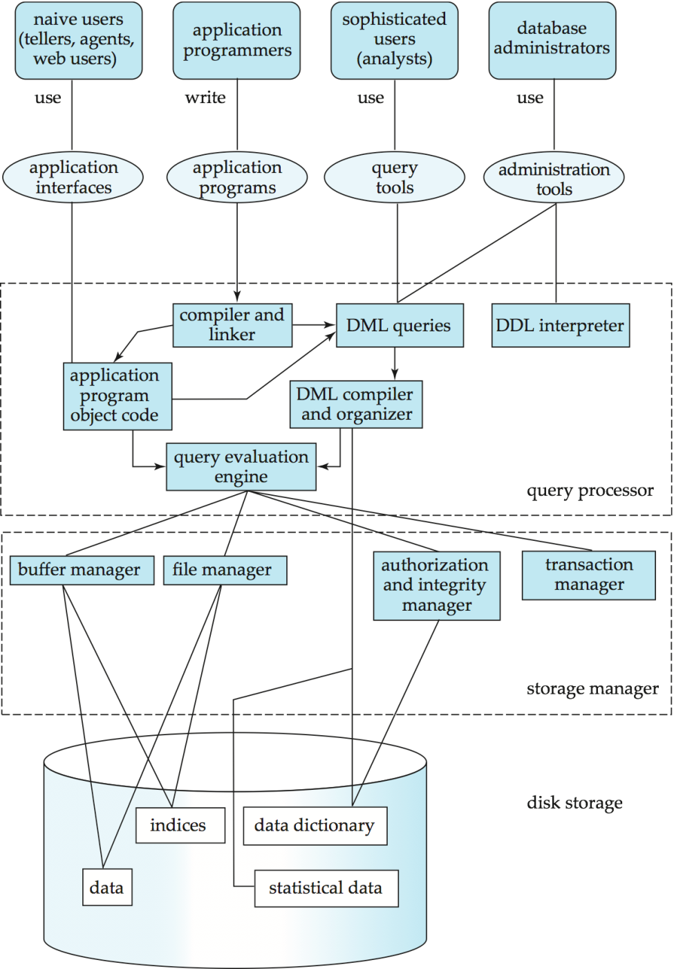
A Database and the Applications
Administrators and Users
Applications, Tools
Query Processing
Storage Management
Disk Storage

Slide 24
HOW do we make it work?
DML (Data manipulation language)数据操纵语言
Language for accessing and manipulating the data organized by the appropriate data model
Mainly querying and insert/delete/update data
DML also known as “query language”
Procedural DML过程式--如SQL底层实现的关系代数是过程的。
user specifies what data is required and how to get those data --根据一个个步骤过程完成操作。
Declarative DML (nonprocedural)描述式--SQL语言通常是描述式的。
user specifies what data is required without specifying how to get those data--只需要知道要什么数据，要什么结果。不需要提供过程。

Slide 25
HOW do we make it work?
DDL (Data Definition Language)数据定义语言
Specification notation for defining the database schema
Maintains database structure, incl. table structure, setting up constraints, etc.
Create table
Domain constraints（数据、字段类型、是否为空、默认值）
Referential integrity（数据之间的相关完整性）
Assertions（数据本身的完整性）一些断言--如年龄不能为负数。
Authorization（数据授权）允许谁访问怎么样的数据？允许谁怎样访问数据。
Data dictionary
DDL compiler generates a set of tables stored in a data dictionary which contains metadata

Slide 26
From Theory to Practice
Data Models
A collection of tools for describing: Data, Data relationships, Data semantic and Data constraints
Relational Model
Relational Algebra
Mathematical basis of SQL
Entity-Relationship data model
A graphical tool for database design
Object-based data model
OO and object-relational
Semistructured data model
XML

Slide 27
From Theory to Practice
SQL
Widely used non-procedural language
Syntax, usage…
Application programs generally access databases through one of these:
Language extensions to allow embedded SQL
Application program interface (e.g., ODBC/JDBC) which allow SQL queries to be sent to a database

Slide 28
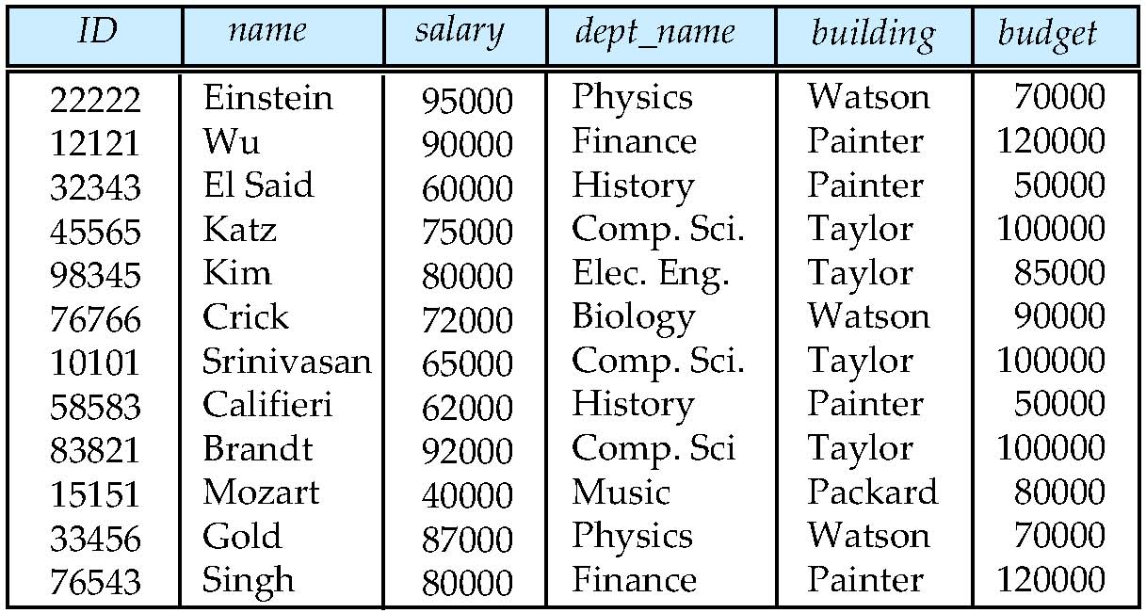
From Theory to Practice
Database Design
Any problem with this design?
数据冗余、需要拆分

Slide 29
From Theory to Practice
Database Design
Issues
What is a “good” collection of relation schemas?
What rules may we follow when we design schemas?
What problems may we encounter in our design process?
Solutions
Normalization
Design process (ERM)

Slide 30
From Theory to Practice
Database organization and relative concepts
Storage
Indexing
Transactions
Query Processing and Optimization *

Slide 31
Application Design
Client/Server Examples
Applications using Open Database Connection (ODBC), Borland Database Engine (BDE), etc.
Two-tier
Browser/Server Examples
Web-based applications using Java servlets, JSP, ASP, etc.
Typically with an application server; three-tier

Slide 32
History
1950s and early 1960s:
Data processing using magnetic tapes for storage
Tapes provide only sequential access
Punched cards for input
Late 1960s and 1970s:
Hard disks allow direct access to data
Network and hierarchical data models in widespread use
Ted Codd defines the relational data model
Would win the ACM Turing Award for this work
IBM Research begins System R prototype
UC Berkeley begins Ingres prototype
High-performance (for the era) transaction processing

Slide 33
History
1980s:
Research relational prototypes evolve into commercial systems
SQL becomes industrial standard
Parallel and distributed database systems
Object-oriented database systems
1990s:
Large decision support and data-mining applications
Large multi-terabyte data warehouses
Emergence of Web commerce

Slide 34
History
Early 2000s:
XML and XQuery standards
Automated database administration
Later 2000s
Giant data storage systems
Distributed and high-performance data storage systems
Management and analysis of streaming data (stock-market ticker data, network monitoring data …)
Widely deployed data-mining techniques (web-based product-recommendation systems …)
Object-relational database
No-SQL and file-based data storage

Slide 35
Think it over
请思考数据库管理系统设计与数据库应用设计的区别。
如同数据结构设计不当将使得算法设计困难一样，数据库设计不当也会使得应用程序的设计变得困难。你认为在实际应用中，数据库设计可能遇到哪些问题？（不讨论数据库管理系统的设计）

Slide 36
Next Lecture
Relational Model

Slide 37
End of Lecture 1 Introduction

